Slide 1



AI based System for human Emotion detection
FYP-BCSM-F23-037

Slide 2
Project Team
Sarah Mahmood (Bcsm-f20-311)
Rabeed Shahid (Bcsm-f20-316)
Supervisor:
Mam Arshia Naeem

Slide 3
Introduction & Background
Imagine an AI based system that not only understands your words but also senses your feelings, responding with empathy and insight. This is the vision we aim to realize through our FYP, as we unveil the concept of an AI Voice and Emotion Detection system. In an era characterized by rapid technological advancement, our project delves into the significance of emotionally aware artificial intelligence, a tool that can genuinely connect with users on an emotional level. Envision a world where technology not only hears our voices but also perceives our emotions, offering a level of understanding and empathy previously reserved for human interactions.
In today's digital landscape, technology is striving to understand us better, aiming not just to respond to our commands but also to perceive our feelings. This initiative drives the creation of AI voice and emotion detection system that go beyond merely understanding words – they aim to comprehend our emotions too. Imagine chatting with your device, and it not only recognizes what you're saying but also senses if you're happy, sad, or frustrated. This ambitious venture comes from incredible advancements in technology. Computers are getting smarter, especially in understanding language and recognizing patterns. They're learning to decode our expressions, tone, and choice of words to interpret emotions, much like how humans do when they talk to each other.

Slide 4
Problem Statement
Understanding human emotions accurately through voice is a complex and challenging task. Traditional methods of emotion detection often rely on visual cues or manual interpretation, which can be subjective and inefficient. There is a need for a reliable and automated system that can accurately detect and classify emotions from voice audio. The lack of such a system limits the ability to provide timely support in areas such as mental health, customer service, and human-computer interaction.

Slide 5
Solution
This project aims to develop an AI-based system that can effectively detect emotions from both pre-recorded audio files and in real-time recordings, providing a robust solution for automated emotion recognition.

Slide 6
Features and Scope
This project features an innovative AI system for detecting human emotions from voice audio, enabling users to upload files for detailed emotion analysis and engage in real-time emotion detection through live recording.
The system identifies a wide range of emotions, offering valuable applications in mental health diagnostics, personalized customer service, interactive virtual assistants, and enhancing human-computer interaction experiences.
The project's scope extends to integrating advanced machine learning algorithms, ensuring high accuracy and efficiency in diverse real-world scenarios.

Slide 7
Requirements
Tools
Tool: Pycharm
Programming Languages:
Languages: Python, , html, css, JavaScript
Purpose: Utilized for frontend website development and backend server-side logic, respectively.
Testing Frameworks:
Frameworks: Selenium (for website) , PyTest (for Python)
Purpose: Enables automated testing of frontend and backend components to ensure code reliability.
Literature Reviews
1. "Emotion Detection via Voice and Speech Recognition"
Author: Dr. Rohit Rastogi Published on: 2023
2. "Speech Emotion Recognition Using Convolution Neural Networks"
Author: Krishna Chauhan Published on: 12 April, 2021

Slide 8
Requirements
List of Different Users
User
Admin
Detector
Use Cases
Functional & Non Functional Requirements

Slide 9
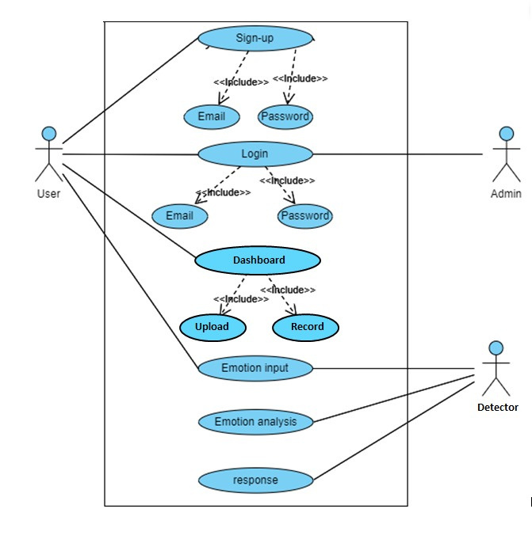
Use Case Diagram

Slide 10
Functional & Non Functional Requirements
Functional Non Functional
Sign up Performance
Login Accuracy
Interact with Dashboard Scalability
Emotion Input Security
Emotion Analysis Reliability
Response Compatibility
Usability
. Adaptability
Testing

Slide 11
System Design
Architecture Design
Entity Relationship Diagram
Class Diagram
Sequence / Collaboration Diagram
Activity Diagram

Slide 12
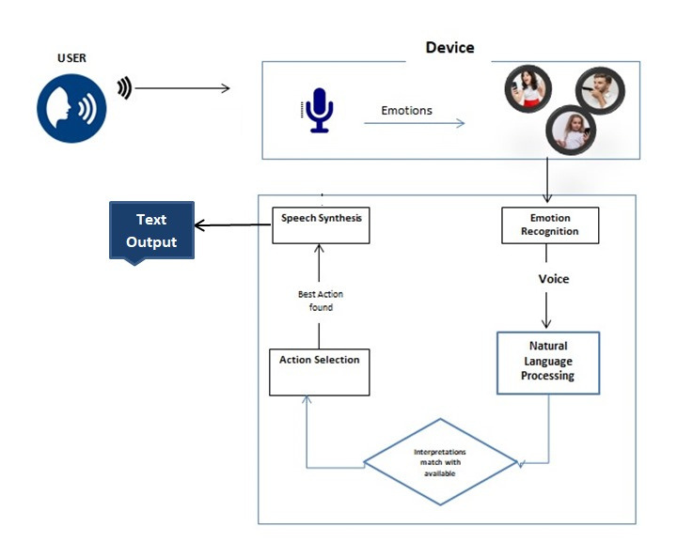
Architecture Design

Slide 13
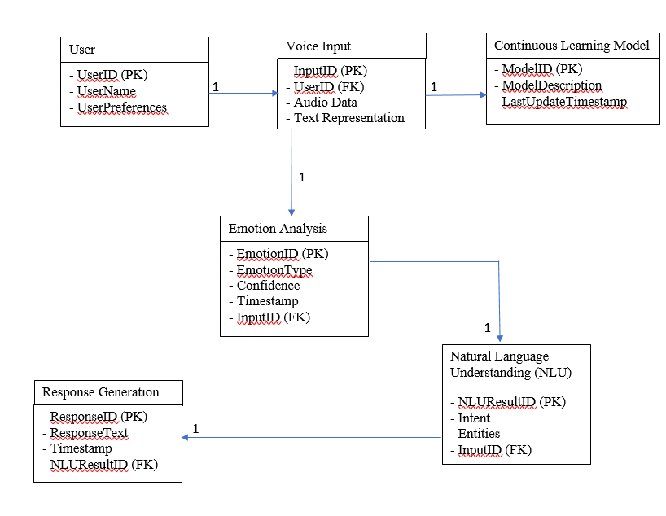
Entity Relationship Diagram

Slide 14
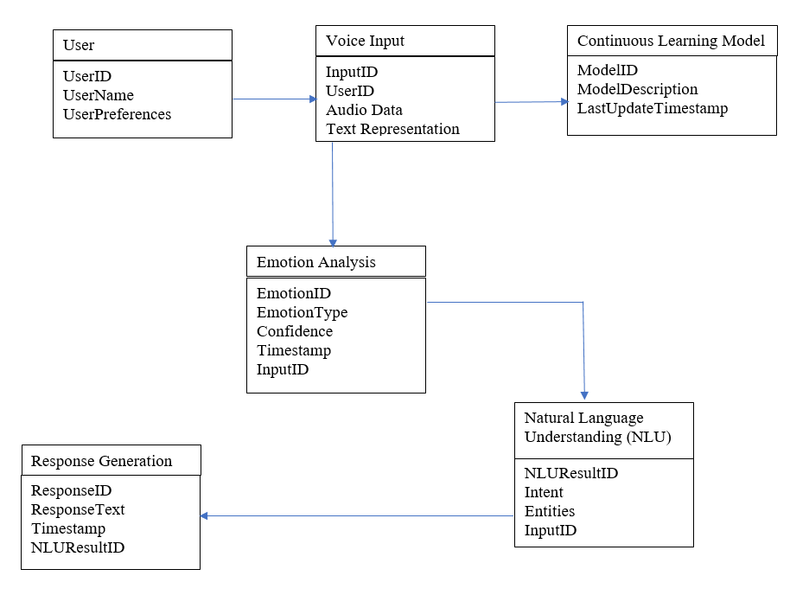
Class Diagram

Slide 15
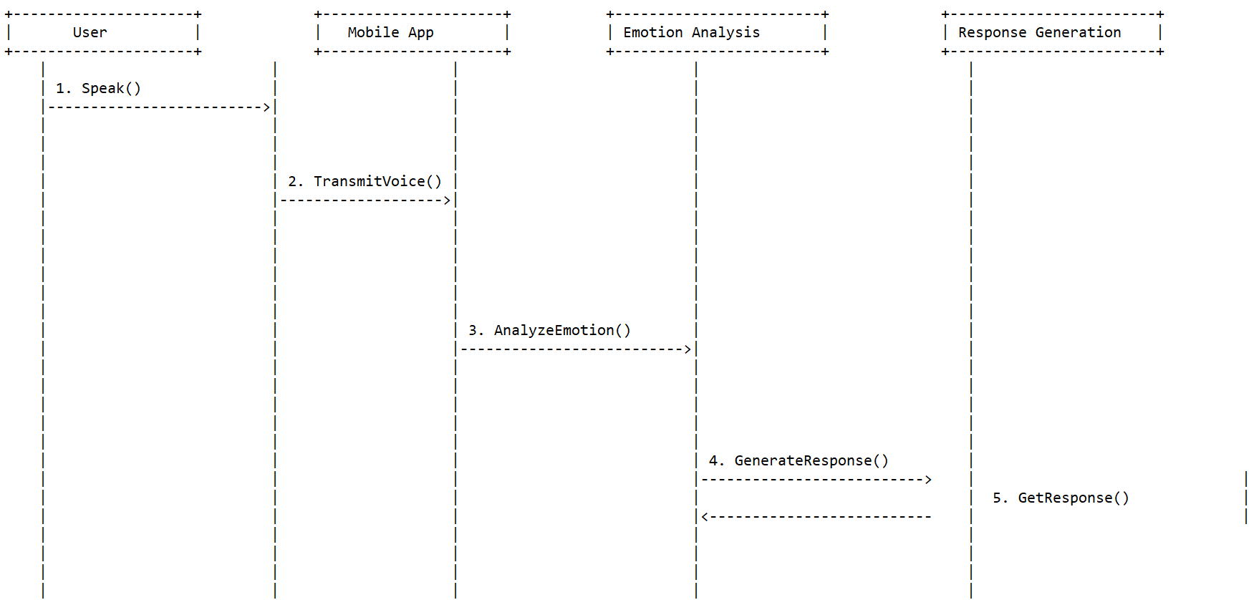
Sequence / Collaboration Diagram
System

Slide 16
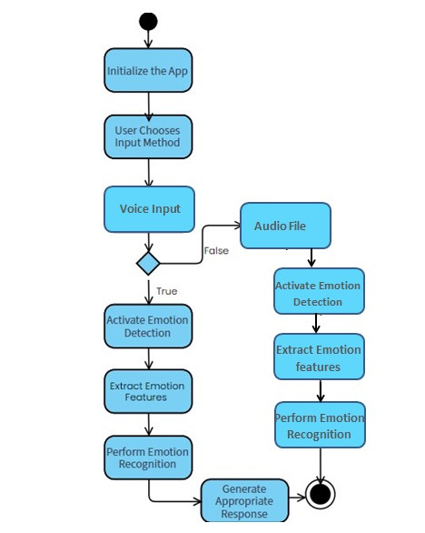
Activity Diagram

Slide 17
Implementation
Development Tools & Technologies:
Best Practices / Coding Standards
Libraries / Components / Web Services

Slide 18
Libraries / Components / Web Services
Libraries:
Additionally installed are librosa, soundile, sklearn, numpy, pickle.
User Profile Management:
Component: Firebase Authentication
Purpose: Manages user authentication and maintains user profiles.
Database System:
Component: Firebase
Purpose: store user login information
Website Development Framework:
Framework: html, css, JavaScript
Purpose: Django is a high-level Python web framework designed to enable rapid development of secure and maintainable websites.

Slide 19
Challenges
Accuracy of Emotion Recognition:
Ensuring precise identification and categorization of emotions
Ambiguity in Emotional Expression:
Emotions are complex
Cross-Modal Emotion Recognition:
Accurately recognizing emotions from voice inputs
User Acceptance and Trust:
Ensuring that users are comfortable and trust the AI with their emotional data
Continuous Learning and Adaptation:
The AI needs to continuously learn and adapt to evolving language nuances and emotional expressions.

Slide 20
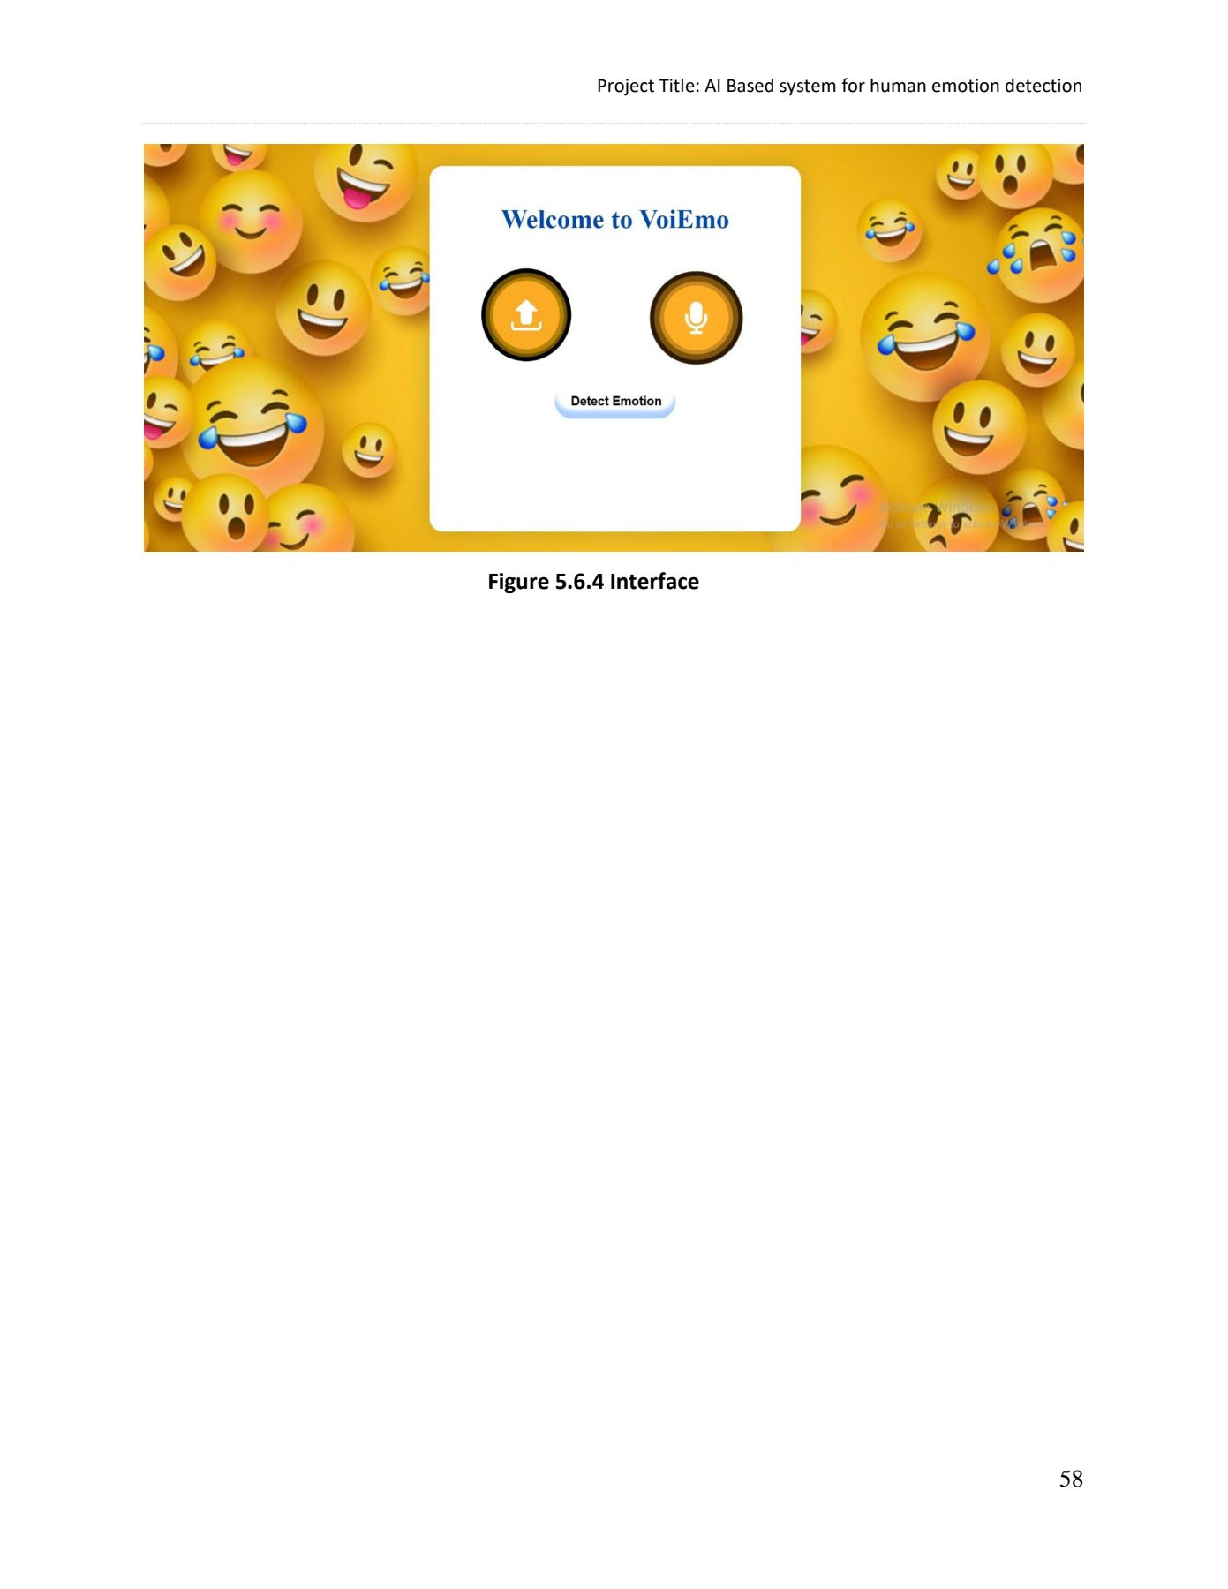
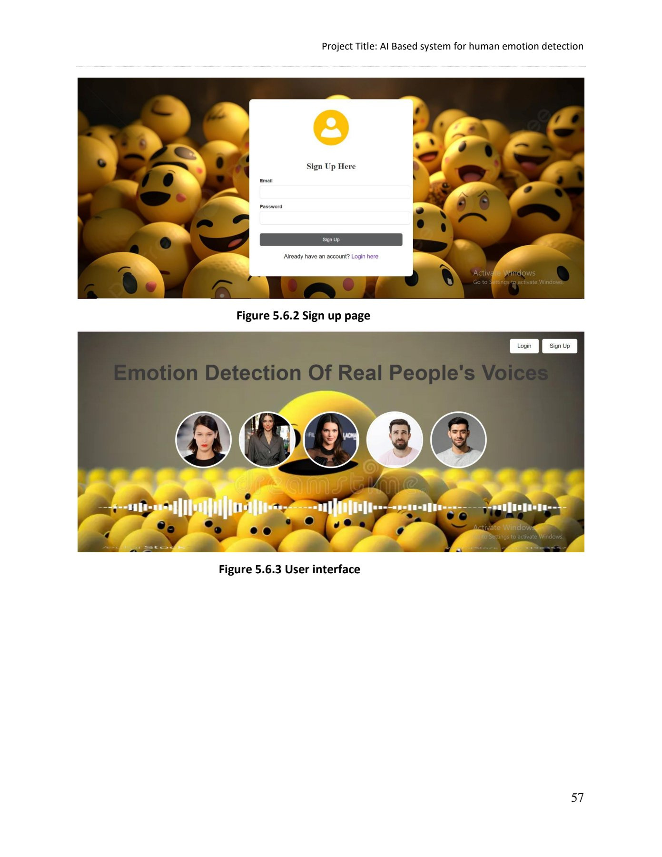
Prototype

Slide 21
Prototype

Slide 22
Report
Link to report:
https://docs.google.com/document/d/1pJKENnk6DEr8_6U574GNeR1XaFA_EdCF/edit?usp=sharing&ouid=108322800326463782905&rtpof=true&sd=true

